Slide 1


Brain Tumor Detection Using Machine learning
S.D.M Jainmatt22Trust®
A.G.M B.B.A & B.C.A COLLEGE, VARUR
Navagraha teerth, NH-4 Road, VARUR-581 207, Dist. Dharwad, Karnataka
Recognized by Govt. of Karnataka, Affiliated to KUD
Phone: 0836-2312071, Mob: 9481087999, E-mail:agmbbabca@gmail.com, Web: www.agmrcet.ac.in
By
Rekha Huchappa Haveri U02IS23S0092
Under The Guidance of
Asst Prof. Ashmeera Haliyal
Department of Bachelor’s of Computer Application

Slide 2
Introduction
Brain tumor detection using Machine Learning is a modern and important application in the field of medical image processing and artificial intelligence. A brain tumor is a serious and life-threatening condition caused by the abnormal growth of cells in the brain. Early and accurate detection of brain tumors plays a major role in providing proper treatment and increasing the chances of patient recovery.
The project uses machine learning algorithms and image processing methods to analyze brain images and identify abnormal tumor regions with high accuracy. By training the model on large datasets of brain MRI images, the system can classify tumors as tumor or non-tumor and assist doctors in making faster and more reliable decisions. This approach reduces manual effort, improves diagnostic efficiency, and supports early treatment planning, making machine learning an important tool in modern medical diagnosis.

Slide 3
Problem Statement
Brain Tumor Detection Using Machine Learning is an advanced healthcare application that helps in the early diagnosis of brain tumors through medical imaging techniques such as MRI scans. The project uses machine learning algorithms and image processing methods to analyze brain images and identify abnormal tumor regions with high accuracy. By training the model on large datasets of brain MRI images, the system can classify tumors as benign or malignant and assist doctors in making faster and more reliable decisions. This approach reduces manual effort, improves diagnostic efficiency, and supports early treatment planning, making machine learning an important tool in modern medical diagnosis.

Slide 4
Objectives
To analyze MRI brain images and identify tumor regions accurately.
To reduce manual errors in medical diagnosis.
To improve the speed and efficiency of tumor detection.
To classify tumors based on image patterns and features.
To assist doctors in early diagnosis and treatment planning.
To achieve higher accuracy using trained machine learning models.
To provide a cost-effective and reliable diagnostic solution.

Slide 5
Scope of the project
The system can be improved to achieve higher accuracy using advanced deep learning models.
It can be extended to detect multiple types of brain diseases, not just tumors.
A mobile application can be developed for easy access by users.
Real-time MRI scan analysis can be integrated in hospitals.
Cloud-based deployment can be implemented for better scalability and storage.
Integration with hospital management systems for automated reporting.
Use of AI-based diagnosis support to assist doctors more effectively.

Slide 6
Technologies
Python is the main programming language used for developing the machine learning model due to its simplicity and powerful libraries.
OpenCV Image processing is performed , which helps in reading, resizing, and enhancing MRI images for better analysis.
NumPy and Pandas are used for numerical computations and data handling.
Scikit-learn and TensorFlow/Keras are used to train and test the dataset for accurate prediction of brain tumors. building the machine learning model.

Slide 7
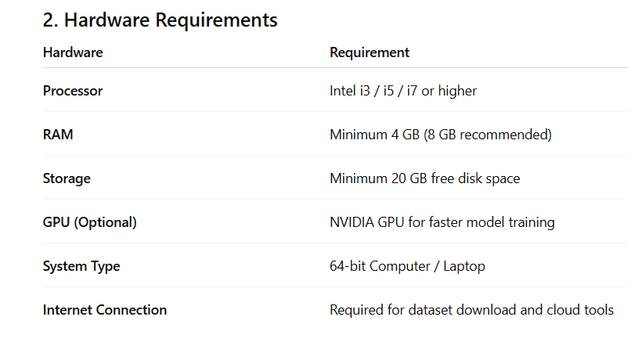
HTML plays a key role in building the front-end interface of the project, making it easy for users to interact with the system.
Flask server acts as bridge between the trained machine learning model and end user.

Slide 8
System Requirements
Functional Requirements
These defines the specific behaviours and services the system must provide.
FR1: User Authentication
The system must allow doctors/technicians to log in using a secure username and password stored in MySQL databases.
FR2: MRI Image Upload
The user must be able to upload MRI scans in formats like .jpg, .png, or .dcm .
FR3: Image Preprocessing
The system must automatically use OpenCV to resize images to a standard dimensions(e.g, 224X224) and normalize pixel values using NumPy.
FR4: Tumor Detection
The TensorFlow/Keras model must analyze the uploaded image and classify it as “Tumor Detected” or “No Tumor Detected”.
FR5: Visualization of Results
The system must display the original image alongside a result page. If a tumo is found, it should highlight the region using Matplotlib.

Slide 9
Non-Functional Requirements
These define “how” the system performs rather than “what” it does.
Performance: The system should provide a detection result within 3-5 seconds of the image being uploaded.
Accuracy: The ML model must aim for a minimum validation accuracy of 90% on the testing dataset.
Scalability: The MySQL database structure should be able to handle at least 1,000 patient records without performance degradation.
Security: Patient data must be protected; passwords must be stored using hashing.
Availability: Since it is a web-based tool, it should be accessible 24/7 via a local server or cloud hosting.

Slide 10
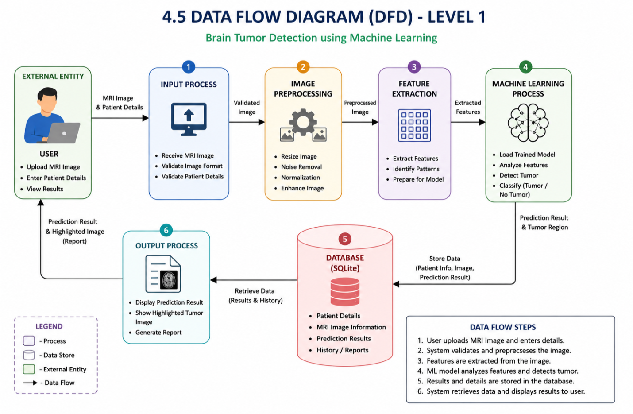
Methodology

Slide 11
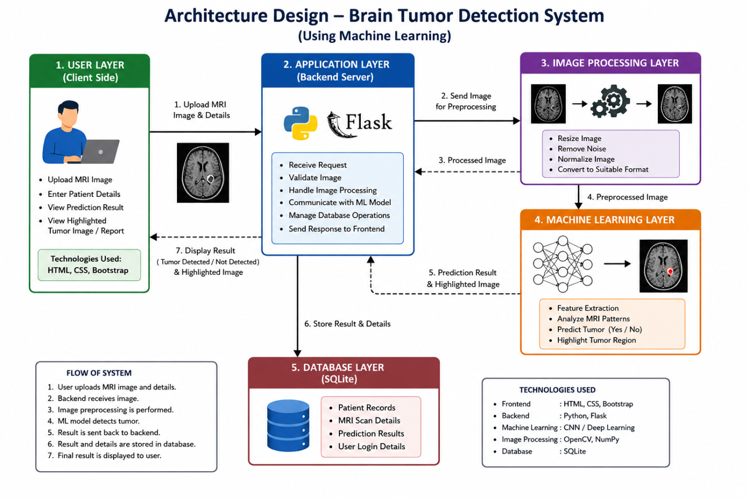
Architecture Design

Slide 12
Modules of the project
Data Collection: This module involves gathering a reliable dataset of MRI scans.
Data Preprocessing: This module ensures the model receives clean, uniform data.
Model Training: Identify patterns, features, & associations within medical imaging data.
Model Evalution: Evaluate model using accuracy, confusion matrix
Detection System: Finding whether tumor is present or not.
User Interface: Develop a GUI to display results to users.

Slide 13
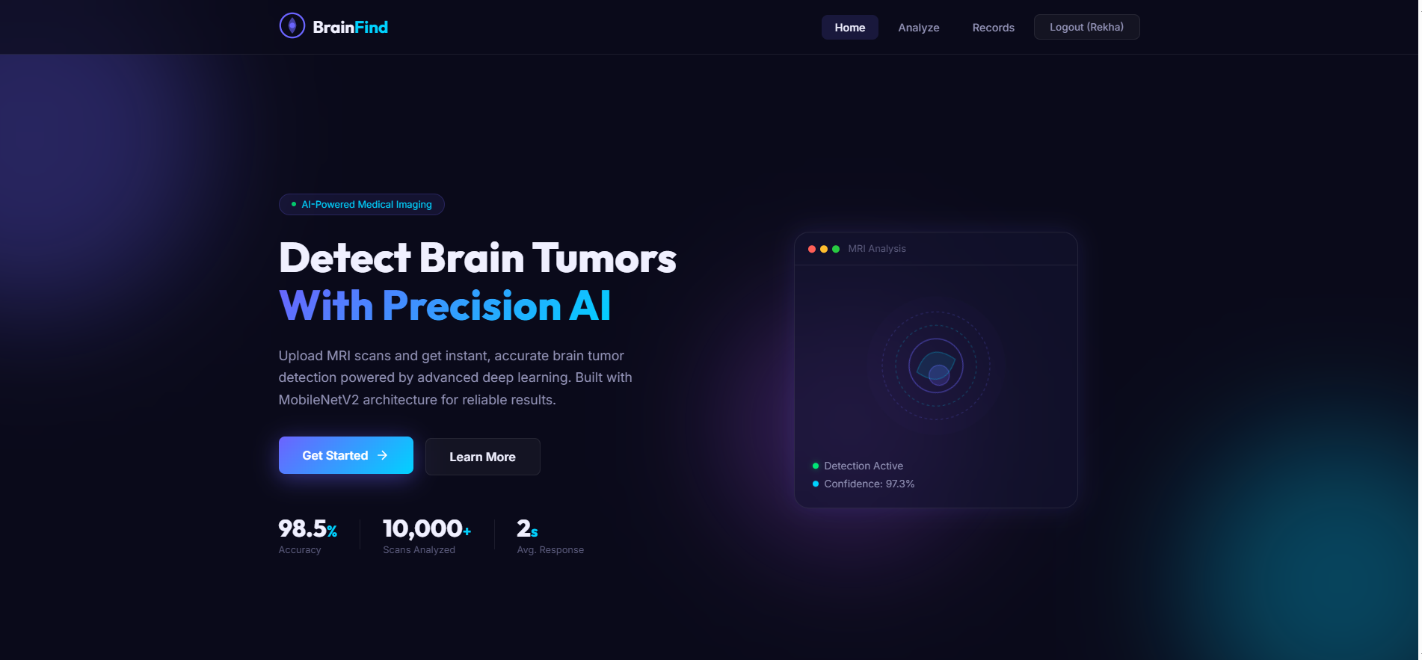
Screenshots

Slide 14
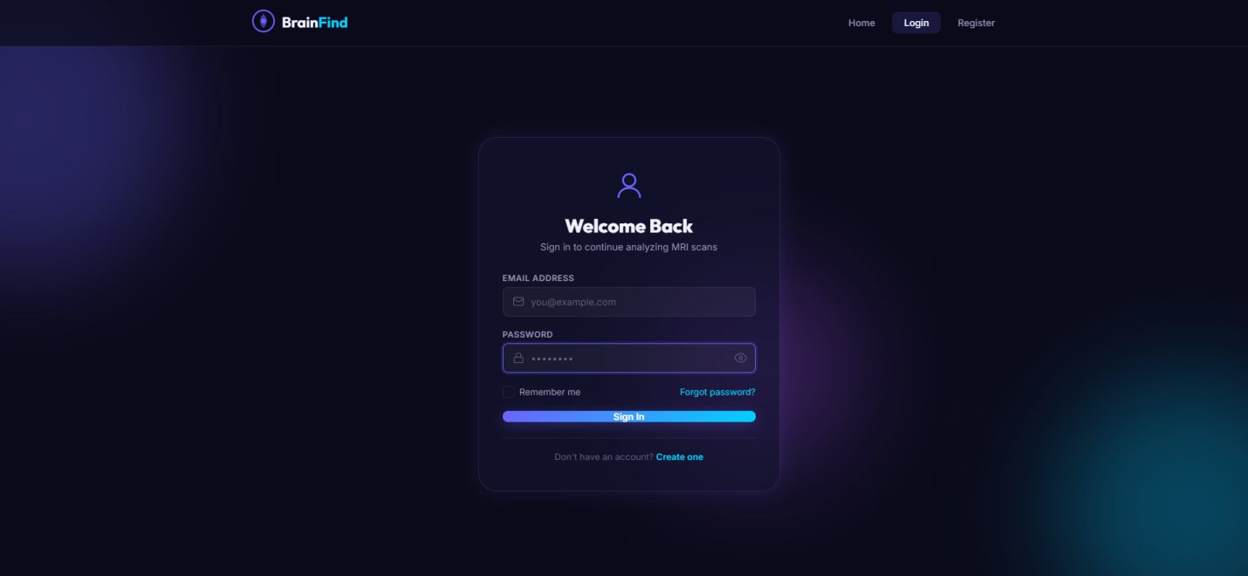

Slide 15
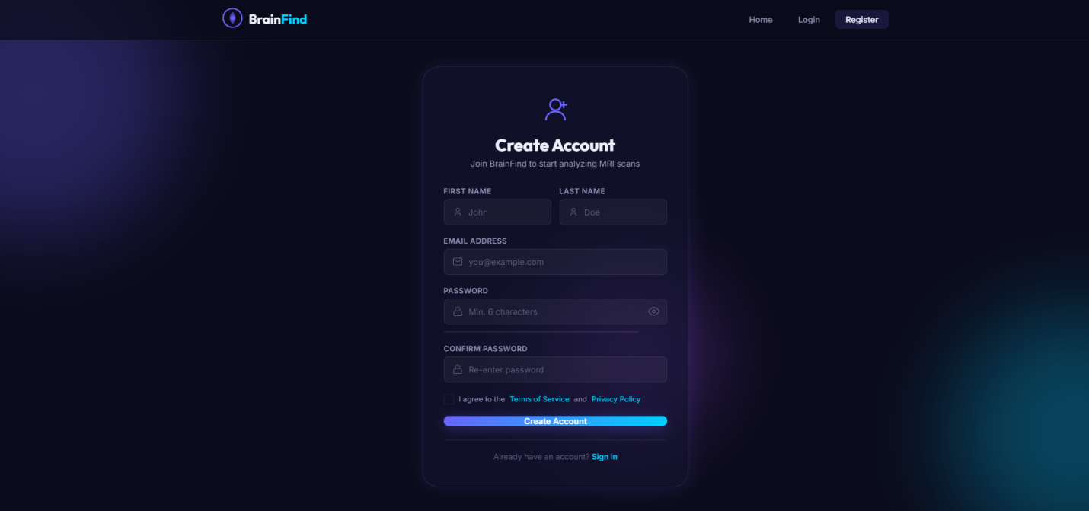

Slide 16
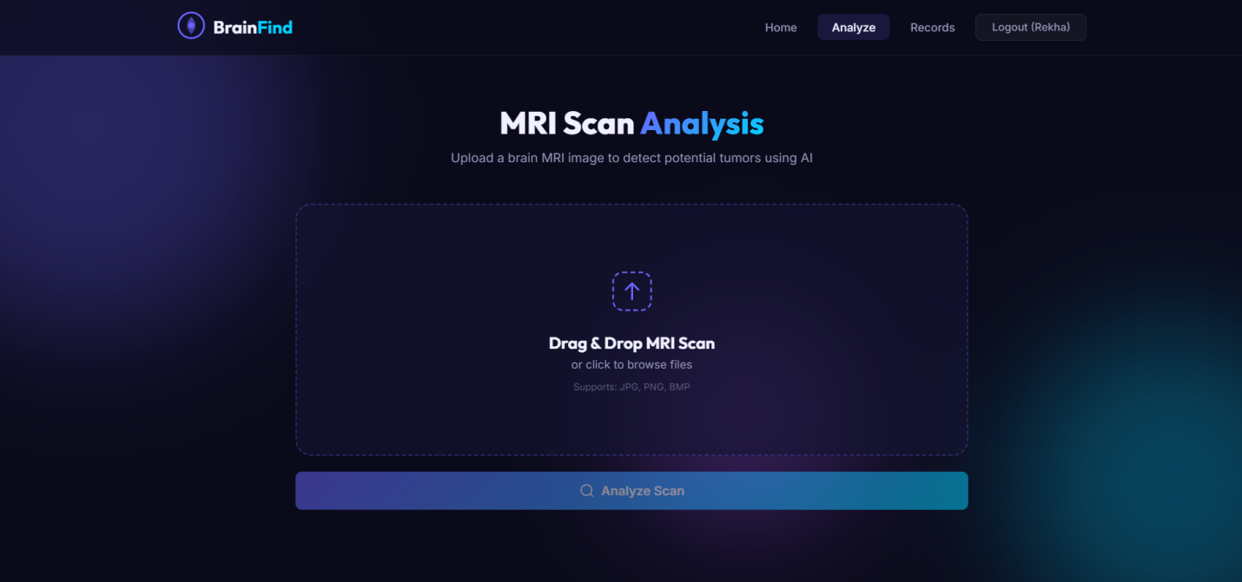

Slide 17
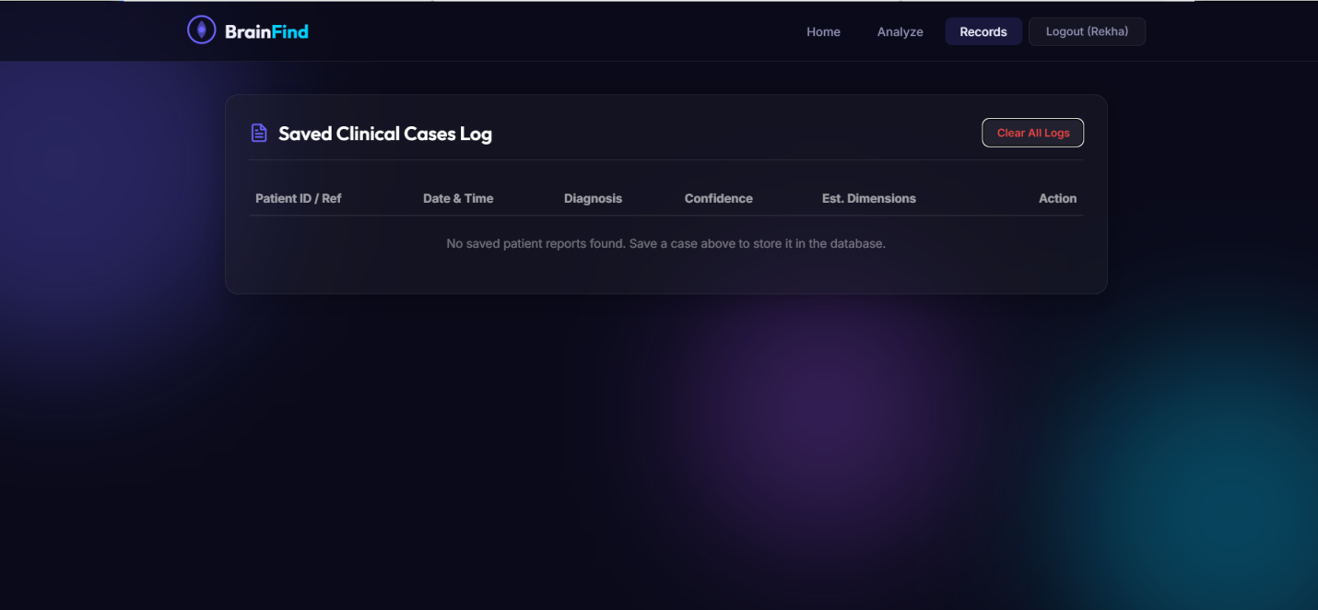

Slide 18
Testing & Results
Test Case ID | Test Scenario | Input | Expected Output | Purpose
TC01 | Tumor Present (Positive Case) | MRI image with tumor | Tumor Detected | Validate correct positive classification
TC02 | No Tumor (Negative Case) | Normal brain MRI | No Tumor Detected | Validate correct negative classification

Slide 19
Advantages
Enhanced Diagnostic Accuracy and Consistency
Significant Time Efficiency
Early Detection and Improved Prognosis
Objective Quantitative analysis
Cost -Effectiveness

Slide 20
Challenge Faced
Data Scarcity & Quality
Data Imbalance
Computational Complexity
Algorithm Bias
Patient Privacy & Consent
Explainability

Slide 21
Limitations
Dependence on Dataset Quality
Limited Generalization
Data Imbalance Problem
High Computational Requirements
Sensitivity to Image Quality
. Lack of Explainability
. Risk of Overfitting
Limited Clinical Validation
Variation in Tumor Types
. Dependency on Preprocessing

Slide 22
Future Enhancements
Advanced Deep Learning Architectures
Data Augmentation Techniques
Hyperparameter Tuning
Improved Image Preprocessing
Transfer Learning
Multi-Class Classification
Explainable AI (XAI) Integration
Web or Mobile Application Deployment
Cloud Integration
Real-Time Prediction System

Slide 23
Conclusion
This project successfully demonstrates the transformative potential of integrating machine learning and deep learning into medical dignostics. By automating the analysis of MRI scans, this system addresses the limitations of manual inspection – namely, the high potential for human error and the time – intensive nature of radiological review.

Slide 24
Bibilography
Datasets
Kaggle Brain MRI Dataset https://www.kaggle.com/
Tools and Libraries
Python Programming Language https://www.python.org/
TensorFlow https://www.tensorflow.org/
Keras https://keras.io/
Scikit-learn https://scikit-learn.org/
OpenCV https://opencv.org/

Slide 25
AI Tools Used
ChatGPT (AI Assistance Tool)
Used as an AI-based assistant for:
Generating project documentation and reports
Designing test cases and system modules
Explaining concepts in simple language
Assisting in coding structure and formatting
Helps in improving documentation quality and project clarity.

Slide 26
GitHub Copilot:
GitHub Copilot is an AI-powered code completion tool developed by GitHub and OpenAI. It assists developers by suggesting code snippets, functions, and entire blocks of code while programming.
AntiGravity (AI Development Tool / Experimental Feature)
AntiGravity refers to an experimental AI-assisted development concept/tool (or coding environment feature depending on usage context) that helps in building and managing software projects using AI-driven automation and suggestions.

Slide 27
Thank You

